Slide 1
Github Demo Using CLI
Abiha
Maidah
Daniyal
Muntaha

Slide 2
workflow
Create a new repo: git init
Commit : downloading a copy of remote repository to your computer using “git clone [repository link]”
Your local repository consists of three "trees" maintained by git. the first one is your
Working Directory which holds the actual files.
Index which acts as a staging area
HEAD which points to the last commit you've made.

Slide 3
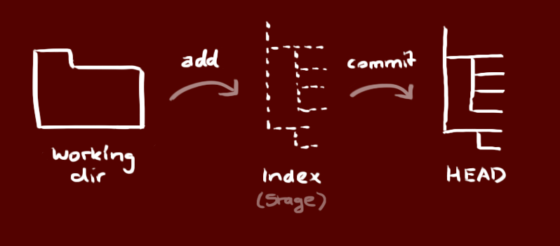
ADD AND Commit
ADD: You can propose changes (add it to the Index) using git add <filename> git add *
COMMIT: To actually commit these changes use git commit -m "Commit message" Now the file is committed to the HEAD, but not in your remote repository yet.

Slide 4
push
pull
--Changes are now in the HEAD of your local working copy. To send those changes to your remote repository, execute git push origin master
--To push your latest commits to your remote repository, use: git push
--If you have not cloned an existing repository and want to connect your repository to a remote server, you need to add it with git remote add origin <server> Now you are able to push your changes to the selected remote server
--git pull is a Git command used to update the local version of a repository from a remote.
By default, git pull does two things.
Updates the current local working branch (currently checked out branch)
Updates the remote tracking branches for all other branches.
git pull fetches (git fetch) the new commits and merges (git merge) these into your local branch.
Notes:
The git pull command is used to fetch and download content from a remote repository and immediately update the local repository to match that content.
Merging remote upstream changes into your local repository is a common task in Git-based collaboration work flows.
The git pull command is actually a combination of two other commands, git fetch followed by git merge.
In the first stage of operation git pull will execute a git fetch scoped to the local branch that HEAD is pointed at. Once the content is downloaded, git pull will enter a merge workflow. A new merge commit will be-created and HEAD updated to point at the new commit.

Slide 5
MERGE
FORCE push
to update your local repository to the newest commit, execute git pull
to merge another branch into your active branch (e.g. master), use git merge <branch> in both cases git tries to auto-merge changes. Unfortunately, this is not always possible and results in conflicts.
Conflict, merge them manually. After changing, you need to mark them as merged with git add <filename>
Git prevents you from overwriting the central repository’s history by refusing push requests when they result in a non-fast-forward merge. So, if the remote history has diverged from your history, you need to pull the remote branch and merge it into your local one, then try pushing again.
The --force flag overrides this behavior and makes the remote repository’s branch match your local one, deleting any upstream changes that may have occurred since you last pulled.

Slide 6
Git Merge conflicts
A merge conflict happens when two branches both modify the same region of a file and are subsequently merged.
Git can't know which of the changes to keep, and thus needs human intervention to resolve the conflict.

Slide 7
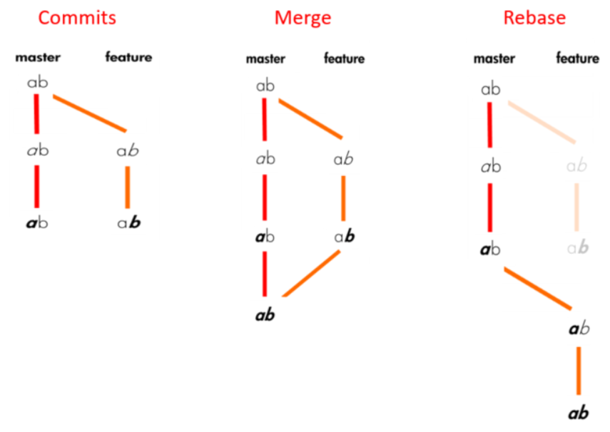
Rebase vs Merge
Rebase
When you do rebase a feature branch onto master, you move the base of the feature branch to master branch’s ending point.
For individuals, rebasing makes a lot of sense.
Merge
Merging takes the contents of the feature branch and integrates it with the master branch. As a result, only the master branch is changed. The feature branch history remains same.
If the feature branch you are getting changes from is shared with other developers, rebasing is not recommended, because the rebasing process will create inconsistent repositories.

